Slide 1
CROP SCIENCE ASSIGNMENT ONE
Group Three

Slide 2
Introduction
On 9th April, 2024. We embarked on a practical tour to the Kapasa Makasa University maize field, eager to uncover the secrets of successful maize cultivation. Our mission was to observe and understand the type of cultivation used, plant spacing, parts of the maize plant, and its growth stage during the 2023/2024 farming season. This hands-on experience would bridge the gap between theoretical knowledge and real world application.

Slide 3
Objectives
To identify the type of cultivation method used in the maize field.
To measure and record the plant spacing.
To observe and identify the different parts of the maize plant.
To determine the growth stage of the maize.

Slide 4
MAIN BODY
Cultivation Method
The maize field employed conventional cultivation with mono-cropping and ridge planting, a tried-and
true approach that optimizes soil preparation, fertility, and weed control. This method involves plowing,
hoeing, and applying fertilizers to create a fertile ground for growth.

Slide 5
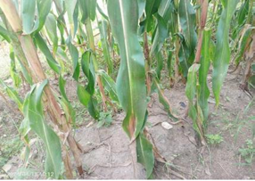
Spacing
The observed plant spacing was approximately 27-30cm between plants and 1m between ridges, allowing for adequate air circulation and sunlight penetration. Each ridge had two lines of plants, carefully arranged to maximize space.

Slide 6
Parts of the Plant
Roots (fibrous roots): the underground network that absorbs water and nutrients.
Stalk: the sturdy pillar that supports the plant's growth.
Leaves: the solar panels that harness the sun's energy through photosynthesis.
Tassels: the reproductive powerhouses that produce pollen for fertilization.
Ear of the cob: contains the grains.
Silks: the delicate threads that facilitate.

Slide 7
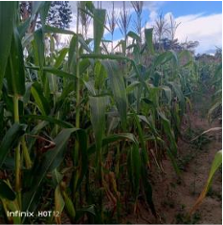

Slide 8
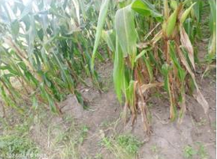
Stage of Growth
The maize crop was in the grain-filling stage, a critical phase marked by rapid grain accumulation and the onset of grain dry matter accumulation.

Slide 9
Soil Conditions
Upon observation, the soil was found to be moistureless, indicating a need for adequate irrigation to support the crop's growth.
Drainage System
Although the field relied on natural rainfall, the drainage system was effective, with no signs of waterlogging. However, ridge planting does not only provide good drainage system, but also prevents soil erosion.

Slide 10
Recommendations
Plant Spacing: Maintain the observed spacing of 27-30cm between plants to ensure optimal growth and yield.
Ridge Spacing: Keep the distance of 1m between successive ridges for convenient movement and farm operations.
Regular Monitoring: Regularly monitor the maize field during the grain-filling stage to identify any signs of nutrient deficiencies, pests, or diseases.

Slide 11
Conclusion
Our tour of the maize field was a resounding success, offering a wealth of knowledge and practical insights into maize cultivation. By embracing these recommendations, we can unlock the full potential of the maize crop and reap a bountiful harvest.

